Slide 1

His
Gracious Words
Luke 4:16-21

Slide 2
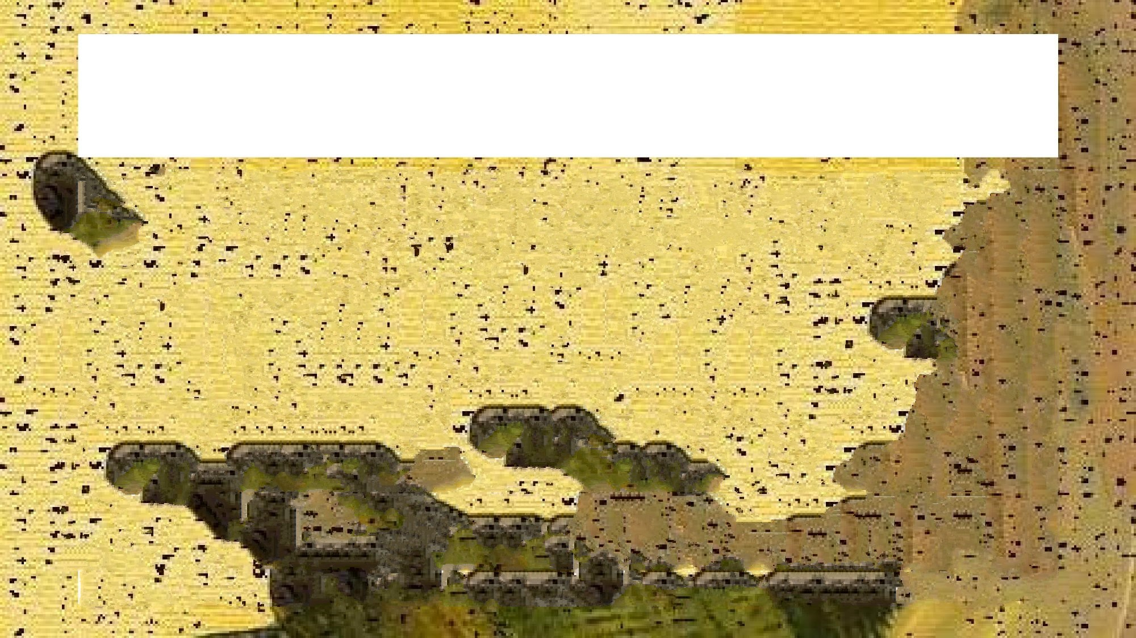
His Gracious Words
His Gracious Words
“The Spirit of the Lord is upon Me, because He anointed Me to preach the gospel to the poor.
He has sent Me to proclaim release to the captives, and recovery of sight to the blind, to set free those who are oppressed, to proclaim the favorable year of the Lord.”
-Luke 4:18-19

Slide 3
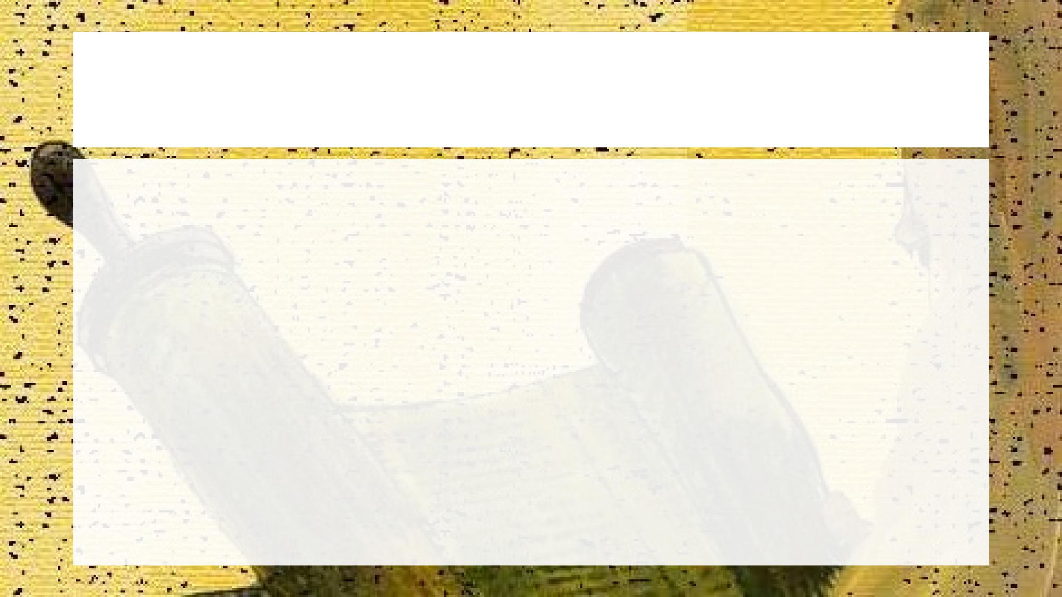
His Gracious Words
“...To Preach The Gospel To The Poor”
Jesus showed compassion for and was received by the poor
Not many rich obey the gospel (Matt. 19:23)
“not many wise...not many mighty...not many noble” (1 Cor. 1:26)
Isaiah 61:1 refers to the “meek” (KJV) or “afflicted” (NASB)
Jesus has in mind those who are “poor in spirit”
“Blessed are the poor in spirit, for theirs is the kingdom of heaven.”
(Matt. 5:3)
“Blessed are the meek, for they shall inherit the earth.”
(Matt. 5:5)

Slide 4
His Gracious Words
“...To Proclaim Release To The Captives”
Those who need the gospel are prisoners
Prisoners to sin (Rom. 6:6)
Prisoners to death (Rom. 6:9)
Christ sets free from spiritual bondage (Rom. 6:16-22)
He liberates those who were “helpless” on their own (Rom. 5:6)
Jesus offers freedom from sin and death
“you will know the truth, and the truth will make you free” (Jn. 8:32)
“and where the Spirit of the Lord is, there is liberty” (2 Cor. 3:17)

Slide 5
His Gracious Words
“To Proclaim... Recovery Of Sight To The Blind”
To open the eyes of the spiritually blind
“And Jesus said, “For judgment I came into this world, so that those
who do not see may see, and that those who see may become
blind.” Those of the Pharisees who were with Him heard these things
and said to Him, “We are not blind too, are we?” Jesus said to them,
“If you were blind, you would have no sin; but since you say, ‘We
see,’ your sin remains.” (John 9:49)
“HE HAS BLINDED THEIR EYES AND HE HARDENED THEIR HEART, SO THAT THEY WOULD NOT SEE WITH THEIR EYES AND PERCEIVE WITH THEIR HEART, AND BE CONVERTED AND I HEAL THEM.” (John 12:40)

Slide 6
His Gracious Words
“... To Set Free Those Who Are Oppressed”
To liberate those who have been crushed and broken by sin
Sin destroys
Sin brings misery
Sin brings shame
Sin brings guilt
Sin “presses down” on the contrite
Christ restores those who come to Him
He relieves the pressure...

Slide 7
His Gracious Words
“... To Proclaim The Favorable Year Of The Lord”
An allusion to the Year of Jubilee (Lev. 25:8-17)
Bond servants were set free and seized land was returned
“intended to typify the messianic liberation” - Butler
To announce that the promised deliverance has come
“On that day the deaf will hear words of a book, and out of their
gloom and darkness the eyes of the blind will see. The afflicted also
will increase their gladness in the Lord, and the needy of mankind
will rejoice in the Holy One of Israel.” (Isa. 29:18-19)

Slide 8
His Gracious Words
“Today this Scripture has been fulfilled in your hearing.”
And all were speaking well of Him, and wondering at the gracious words which were falling from His lips”
-Luke 4:22

Slide 9
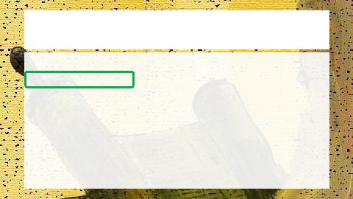
His Gracious Words
“And all were speaking well of Him, and wondering at
the gracious words which were falling from His lips”
-Luke 4:22

Slide 10
His Gracious Words
“To those who feel their spiritual poverty, whose hearts are broken through a sense of their sins, who see themselves tied and bound with the chains of many evil habits, who sit in the darkness of guilt and misery, without a friendly hand to lead them in the way they should go – to these, the gospel of the grace of Christ is a pleasing sound...”
-Clarke’s Commentary

Slide 11
His Gracious Words
“And all were speaking well of Him, and wondering at the gracious words which were falling from His lips”
-Luke 4:22
Are you tired of stumbling in darkness?
Is the weight of sin more than you can bear?
Do you want to be set free?
Are you willing to humble yourself?
Jesus has good news for you

Slide 12
God’s Plan of Salvation
GOD'S PART
The great love of God for man (Jn 3:16)
He gave His Son, Jesus Christ, as the Savior (Lk 19:10)
Sent the Holy Spirit as a guide (Jn 16:13)
Gave the Gospel as "the power" unto salvation (Rom 1:16)
Provided atonement by the blood of Christ (Rom 5:9)
MAN'S PART
Hear the Gospel (Rom 10:17, Jn 8:32)
Believe the Gospel (Heb 11:6, Jn 20:31)
Repent of past sins (Lk 13:3, Acts 17:30)
Confess faith in Jesus Christ (Rom 10:10, Matt 10:32)
Be Baptized (Gal 3:27, Mk 16:16, Acts 2:38)
Be faithful unto death (Rev 2:10)
God has done His part. Have you done yours?

